Slide 1
Increase in Solar and Wind Energy Production
Are the G7 countries the world leaders?

Slide 2
Data from: United Nations Statistics Division - Annual Questionnaire on Energy Statistics (1990 - 2015)
Our World In Data: Share of electricity production from wind (2020)
Irena.org: Renewable Capacity Statistics (2020)
Additional sources:
International Energy Agency Center for Climate and Energy Solutions

Slide 3
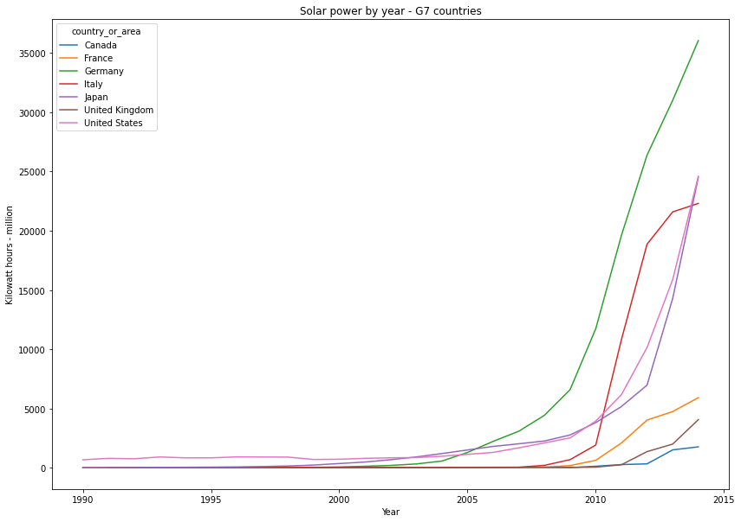
Solar power
G7 countries: 1990 - 2015

Slide 4
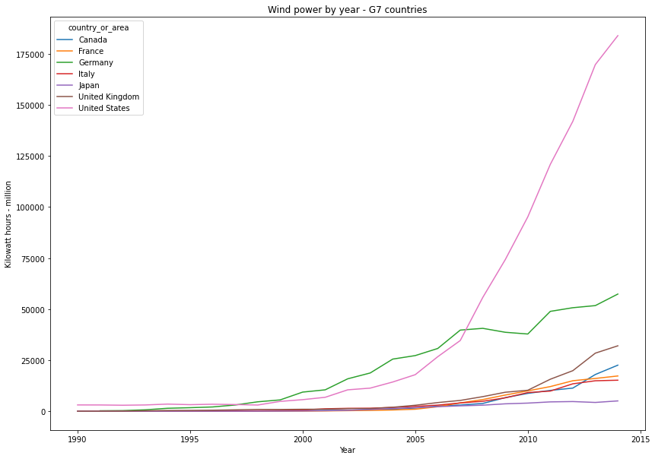
Wind power
G7 countries: 1990 - 2015

Slide 5
Increase in all G7 countries
Steep increase in wind in U.S.
Steep increase in solar in Germany, Italy, Japan and the U.S.

Slide 6
Those numbers are total kilowatt-hours in the millions. Big numbers. Impressive numbers.
But, what about per capita?

Slide 7
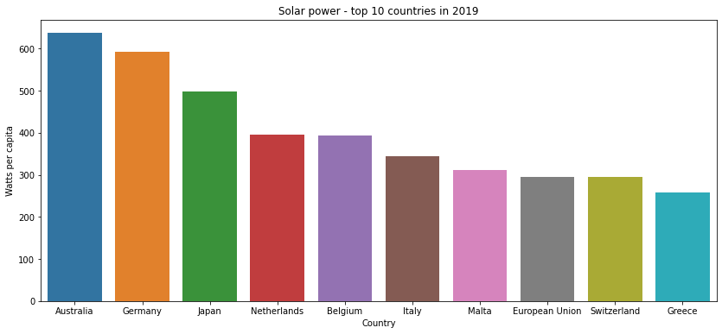
Solar power per capita
Top 10 countries
Germany, Italy, and Japan are the only G7 countries in the top 10

Slide 8
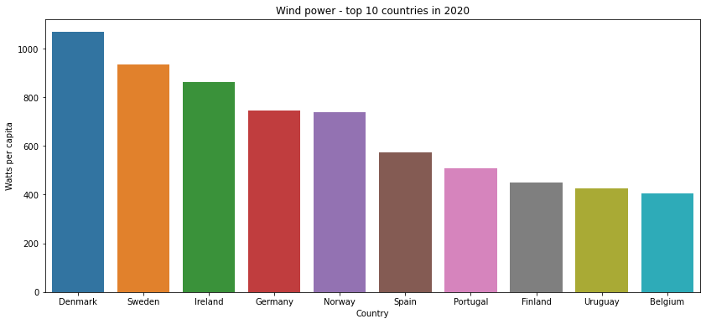
Wind power per capita
Top 10 countries
Germany is the only G7 country in the top 10

Slide 9
Solar energy (just 3.3% of total U.S. energy generation in 2020) is the fastest-growing electricity source in the world.
Wind power is the primary non-hydro renewable technology, generating nearly as many terawatts per hour as all others combined.

Slide 10
China is the global leader in the volume of additions to renewable energy capacity, with India close behind.
Members of the G7 = world’s largest advanced economies and wealthiest liberal democracies

